Slide 1
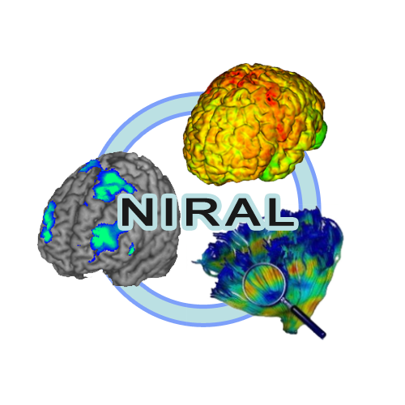
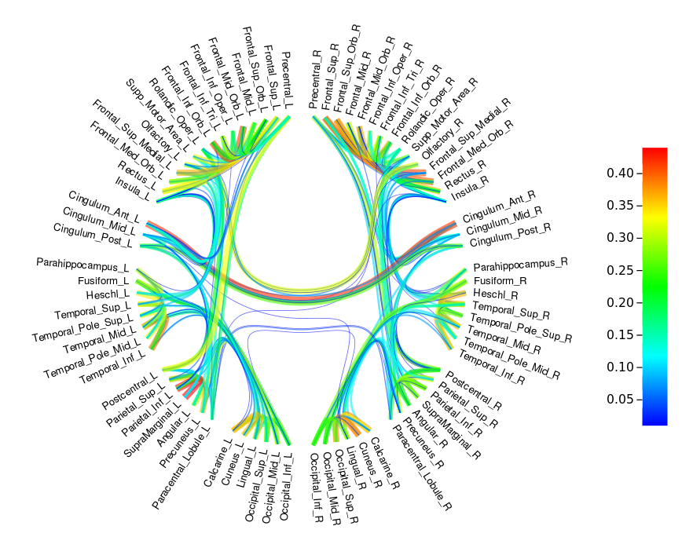
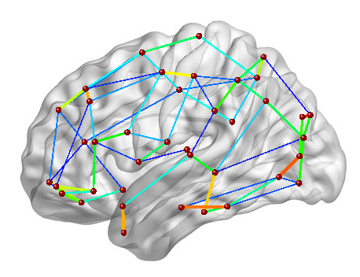
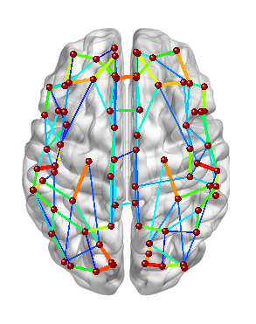
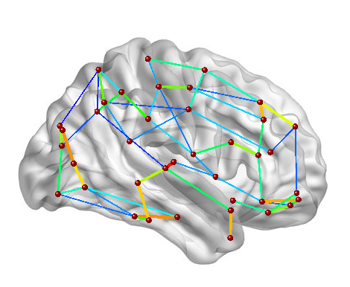
CIVILITY : cloud based Interactive Visualization of Tractography Brain Connectome
Tutorial
Circle visualization
Brain template visualization
UNC Neuro Image and Research Analysis Laboratories | Danaele Puechmaille, Juan Carlos Prieto, Martin Styner
DP : danaele@email.unc.edu, JCP : jprieto@med.unc.edu, MS : styner@cs.unc.edu

Slide 2
CIVILITY : cloud based Interactive Visualization of Tractography Brain Connectome
CIVILITY is a web application and has mainly 2 components.
- CIVILITY-visualization ; front end of the application. This is a circle plot of the brain connectivity using the method of visualization : Hierarchical Edge Bundling. The graphic visualization of the brain connectivity is generated using Data Driven Documents (D3.js).
- CIVILITY-tractography ; analysis pipeline. The analysis of the brain connectome is computed using a probabilistic method (FSL tools) using surfaces as seeds.

Slide 3
CIVILITY : cloud based Interactive Visualization of Tractography Brain Connectome
CIVILITY performs the brain connectivity analysis in remote computing grids where the CIVILITY-tractography pipeline is deployed. CIVILITY uses clusterpost (https://github.com/NIRALUser/clusterpost) to submit the jobs to the computing grid.
NOTE : clusterpost clusterpost is a server application providing a REST api to submit jobs in remote computing grids using. Data transfer, job execution and monitoring are all handled by clusterpost.
The front end of CIVILITY submits tasks to clusterpost and retrieves the results when they are finished.

Slide 4
CIVILITY : cloud based Interactive Visualization of Tractography Brain Connectome
Tractography pipeline
Run application
Login, create an account, reset password
Run tractography on one subject
View jobs launched
Visualization of the connectivity
Download outputs

Slide 5


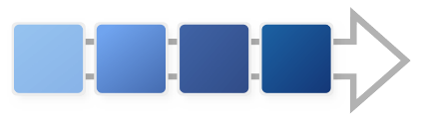
CIVILITY : cloud based Interactive Visualization of Tractography Brain Connectome
Tractography pipeline
Outputs
Inputs
All images and surface(s) must be in diffusion space (DWI space)
DWI
T1
Connectivity
Matrix for visualization
Create input directory for bedpostX and convert dffusion data (.nrrd to .nii.gz with DWIConvert)
BedpostX (FSL tool) : Fitting of the probabilistic diffusion model on corrected data
Creation of surfaces for each brain regions (colored in a vtk file) and create a text file of seeds list (for tractography)
Tractography according to the seeds list (probtrackx2 FSL)
Brain mask
Description of
parcellation table
Output directory contains all necessary files in the tractography pipeline
Vtk surface(s) with labels
Parameters
BedpostX and probtrackx2 (FSL tools) parameters used are specified in the Documentation.
The tractography can take ~1 week of computation

Slide 6



CIVILITY : cloud based Interactive Visualization of Tractography Brain Connectome
Run application
Open an internet browser and go to this web page :
https://tethys.med.unc.edu:8180
→ If the browser warning you about certificates, permissions – you must accept the exceptions and get the certificate.
Go in advanced options in your browser and Add exception to get the certificate and then confirm the security exceptions.

Slide 7
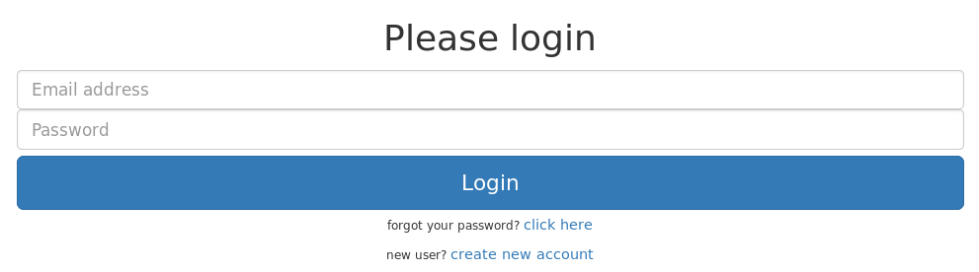

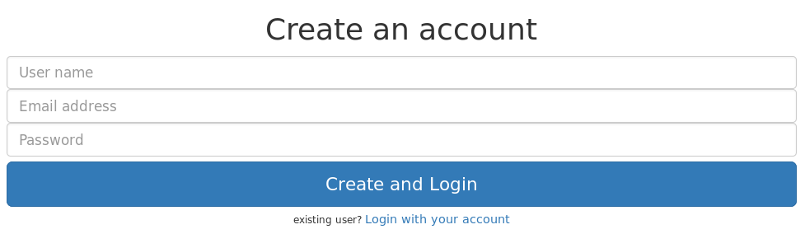
CIVILITY : cloud based Interactive Visualization of Tractography Brain Connectome
Home page : Login, create an account, reset password
Do you have an account ?
Click on create new account
You will be redirected to the page below
Enter your Email address and password and then click to Login button
No
Yes
Fill this form : a username, a valid email address and a password and then click on Create and Login button
The password must contain 6 characters, including at least one uppercase letter, one lowercase letter, one number
Forget password ?
If you don't remember your password, fill the field Email Address in the Login page and then click on the link : click here.
An email will be sent to your email address containing a link. This link will redirect you to a reset page. On the page you need to type 2 times your password and then click on Reset and Login button
You still can return to the login page by clicking to Login with your account

Slide 8
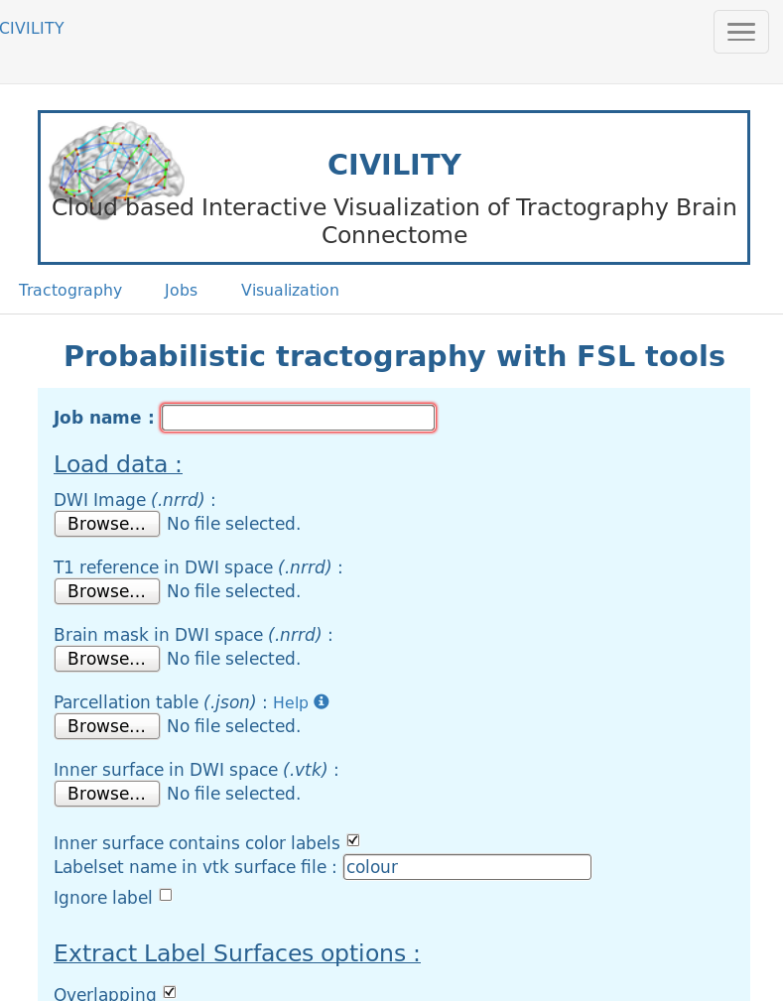
CIVILITY : cloud based Interactive Visualization of Tractography Brain Connectome
Application
At this point, you must be connected.
Otherwise, return to the last slide to be Login.
Tabs 1 and 2 are accessible only if your administrator authorized you to access. If, you don't have access, send a request of access by email to your administrator.
This application is composed of 3 tabs.
Tab 1 : Tractography
Launch a tractography on a subject
Tab 2 : Jobs
Summarize of all jobs launched. You can visualize results, status, parameters etc.
Tab 3 : Visualization
Here, you can visualize brain connectivity by uploading a matrix file (probtrackx2 output) and a description table (json file).
Preview of the application when you are Login.

Slide 9

CIVILITY : cloud based Interactive Visualization of Tractography Brain Connectome
Run tractography on one subject – Tab 1
Now, let's try to run the tractography on one subject.
1. Specify an id for the subject and upload images
Specify the id/name of the subject (This id/name gonna be the name of the directory containing all outputs of the pipeline)
Upload the DWI (diffusion) image – format : nnrd
Upload T1 image (must be in the same space as the DWI image → diffusion space) – format : nnrd
Upload brain mask ( in diffusion space ) – format : nnrd

Slide 10

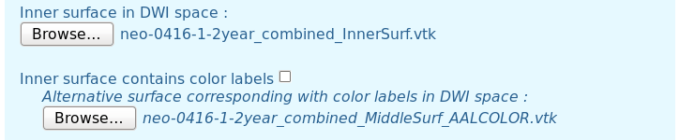
CIVILITY : cloud based Interactive Visualization of Tractography Brain Connectome
Run tractography on one subject - Tab1
2. Upload description table and surface(s) files
Upload the parcellation table (json file) – format : vtk / see Appendix 1
Upload the Inner surface (in diffusion space) – format : vtk
This surface contains labels for each region ? Check the box if yes, unchecked if no (default : check)
If the surface doesn't contain labels, you must upload another surface (same mesh, same space) containing labels

Slide 11
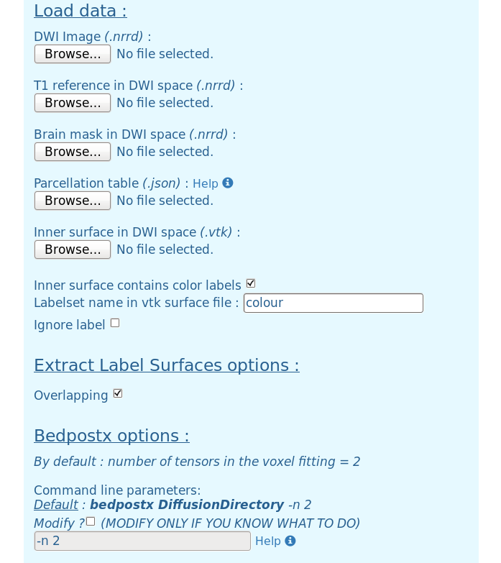
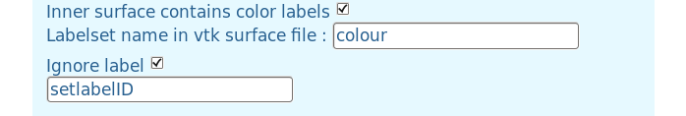
CIVILITY : cloud based Interactive Visualization of Tractography Brain Connectome
Run tractography on one subject - Tab1
3. Parameters specific to the extraction of label surfaces in the whole brain surface
Fill the text field by the name of the labelset in the vtk file
If you want to ignore a label in the vtk file, check to box “Ignore label” and enter the value/ID of the label to ignore (example : “0 0 0” )
There is an additional option in the surfaces extraction : overlapping. If the checkbox corresponding to “Overlapping” is selected that mean each region overlaps the neighboring regions. (by default : selected)

Slide 12
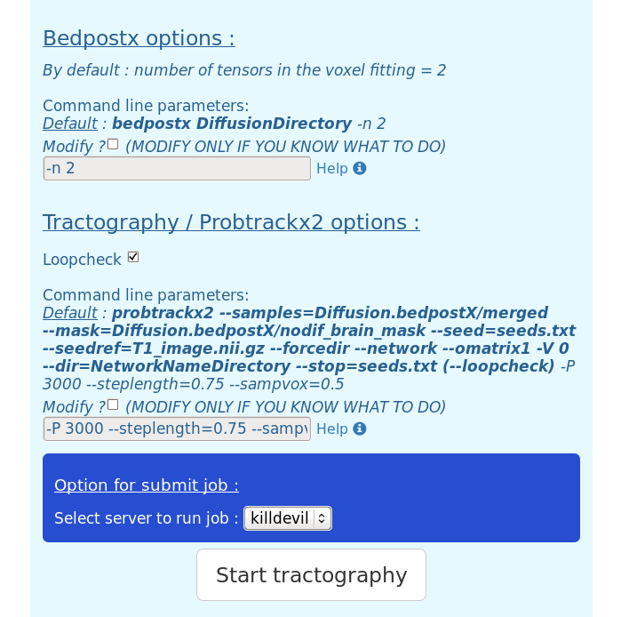
CIVILITY : cloud based Interactive Visualization of Tractography Brain Connectome
Run tractography on one subject - Tab1
For FSL tools, it's possible to modify their parameters. Parameters write in bold can't be modified.
4. Bedpostx parameters
By default the number of tensors in the voxel fitting is equal to 2. You can modify bedpostx parameters if you are familiar with this tool by clicking on the checkbox “Modify“.
5. Probtrackx2 parameters
Select loopcheck or not for the tractography computation
Probtrackx2 help → Loopcheck: By default, we terminate pathways that loop back on themselves -i.e. paths that travel to a point where they have already been.
You can modify probtrackx2 parameters if you are familiar with this tool by clicking on the checkbox “Modify“.

Slide 13
CIVILITY : cloud based Interactive Visualization of Tractography Brain Connectome
Run tractography on one subject - Tab1
6. Select a server and run tractography
Select server where the tractography is computed – by default the first server found is selected
Finally click on “Start tractography” button to submit the job to server selected before.
During the job submission the button “Start tractography” is disabled and it will be usable again when the job is created and submit.
Tractography can take +/- 1 week of computation

Slide 14
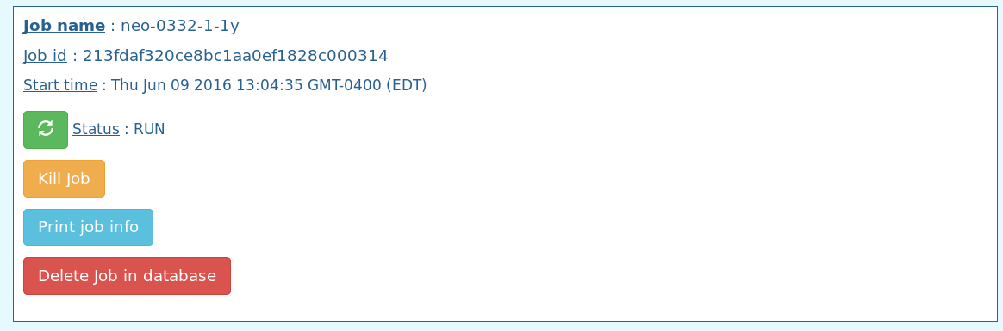

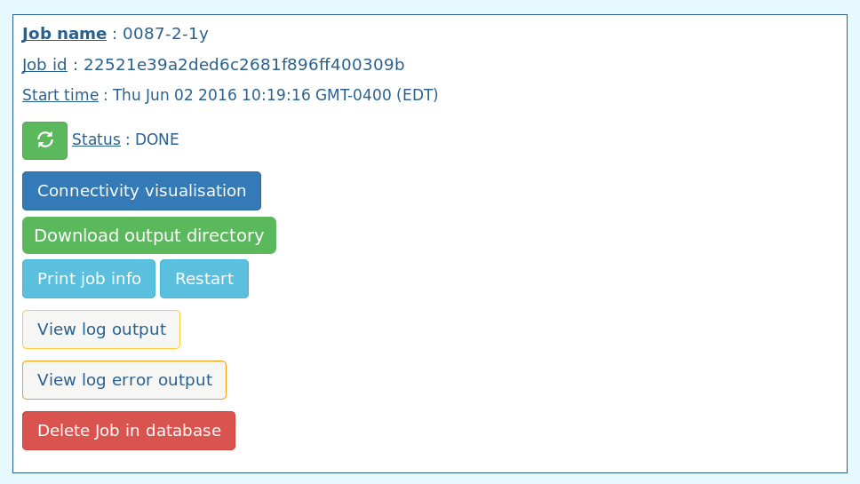




CIVILITY : cloud based Interactive Visualization of Tractography Brain Connectome
View jobs – Tab 2
This tab allows the user to have a summary of all jobs (tractography on one subject) launched.
First, select which jobs to print by selecting a status. (Default : DONE)
Refresh page
Options :
According to the status of the job, options are available or not.
Update status → you can update the status of the job by clicking on this button
Connectivity Visualization → see appendix 2
Download output directory → to save the results in your system
Print job information → allow user to check the files ulpoaded and parameters submitted

Slide 15

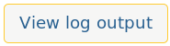
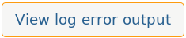


CIVILITY : cloud based Interactive Visualization of Tractography Brain Connectome
View jobs – Tab 2
Restart job → you can restart the job at any time.
If the status is CREATE, you can restart the job easily. For all other status, you had to force the job submission. Before force the job submission, check the output log files and check inputs files you've uploaded to be sure you've submitted nothing wrong.
View logs output →Print the content of the log output file
If the line : ERROR_PIPELINE_PROBTRACKBRAINCONNECTIVITY appears in the log file, that means there is an error during the pipeline, so input files or parameters submitted are wrong.
View log error output → Print the content of log error output file
Kill Job → kill the job which is currently running
Delete Job → delete the job from the database

Slide 16
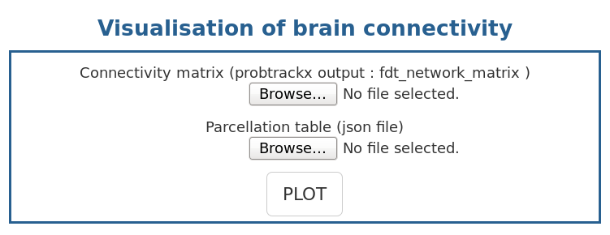
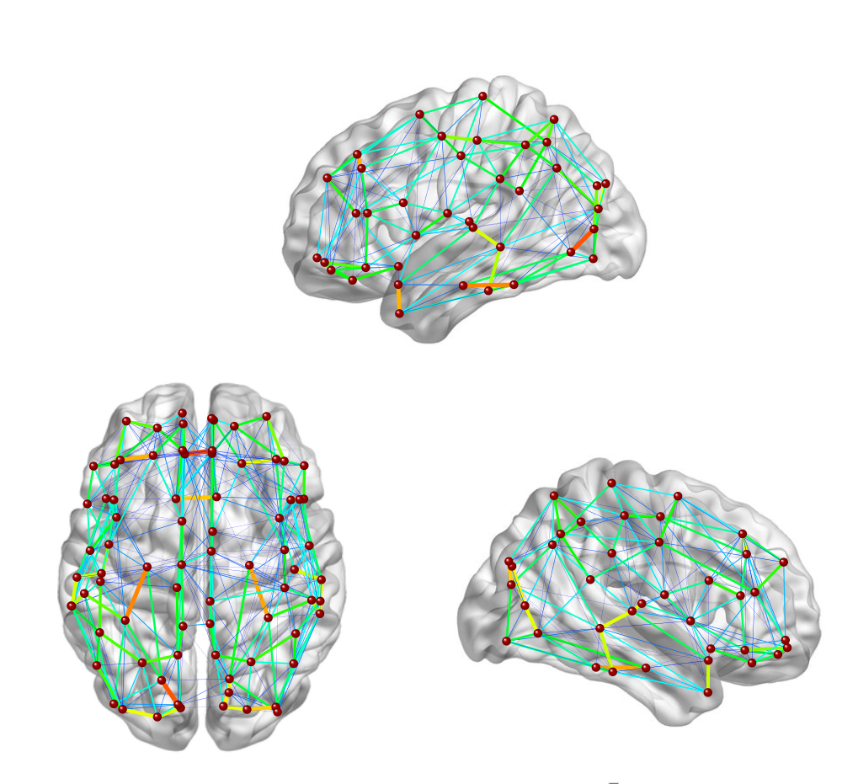
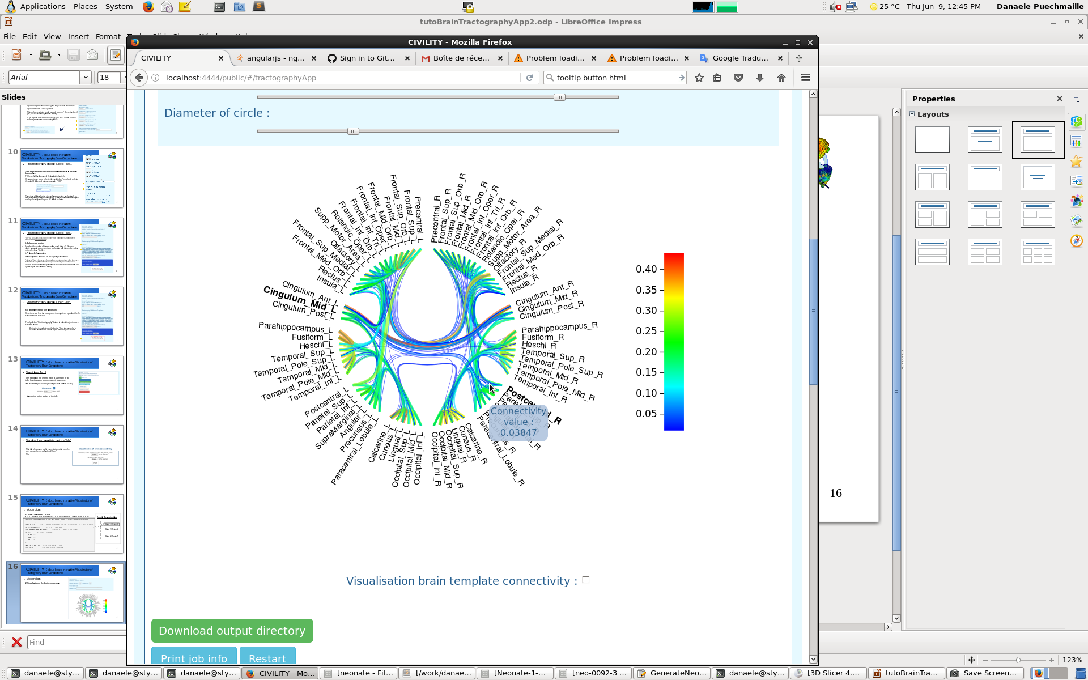
CIVILITY : cloud based Interactive Visualization of Tractography Brain Connectome
Visualize the connectivity matrix – Tab 3
This tab allows users to plot connectivity matrix from the user system files by uploading 2 files :
-Connectivity matrix : output of probtrackx2
-Parcellation table : json file → see appendix 1
To visualize the brain connectome click on PLOT,
and the circle plot appears. → see appendix 2

Slide 17

CIVILITY : cloud based Interactive Visualization of Tractography Brain Connectome
Appendices
1 . Description table template - json file
This file is a description of the parcellation table.This json object is an array of objects defined like bellow :
{ //Object corresponding to one region – this example is based on the AAL90 parcellation table
"VisuOrder": 78, //This is the rank in the circle plotting
"MatrixRow": 1, // Rank in the connectivity matrix - first row = 1 = first column ( if = -1 not in the matrix )
"name": "Precentral_L", //Name of the region/seed
"VisuHierarchy": "seed.left.frontal.", //Hierachy of the seed (for circle plotting)
"coord": [ //Coordinates of the seed
-38.65, // X
-5.68, // Y
50.94 // Z
],
"labelValue": "131 44 78", //Value of the label in the vtk file
"AAL_ID": 1 // label/seed ID in the AAL90 table
}
Json file / Description table
[
{
Object 1 / Region 1
},
{
Object 2 / Region 2
},
…
{
Object N / Region N
}
]

Slide 18
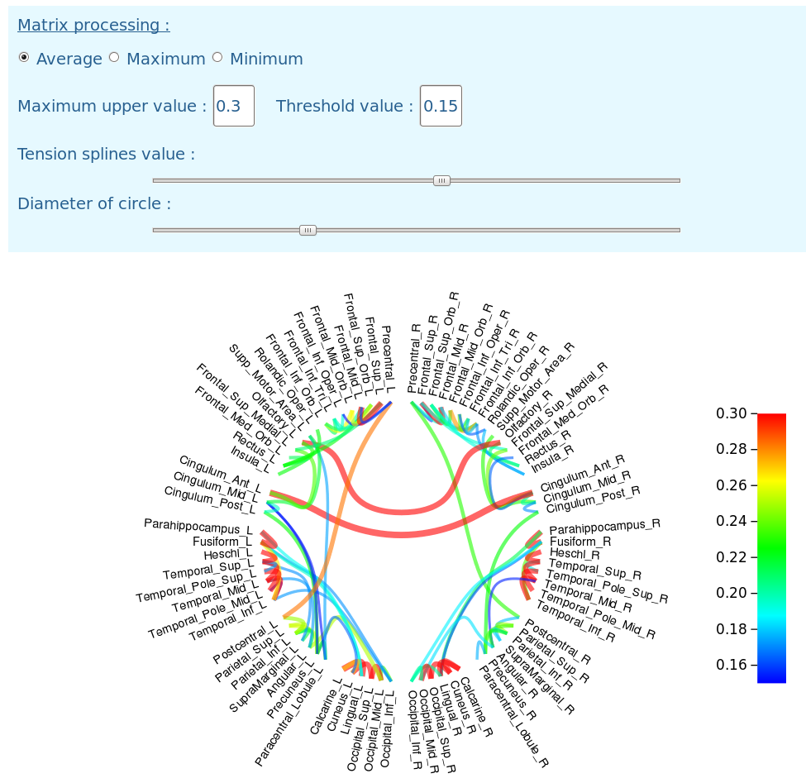

CIVILITY : cloud based Interactive Visualization of Tractography Brain Connectome
Appendices
2. Visualization of the brain connectome – Parameters
The brain connectome plot is the result of the connectivity matrix (output of probtrackx2) normalized by the number of streamlines per seeds (rows) and then triangulate. The triangular matrix can be computed by 3 different ways.
Average between the lower and upper triangular matrix
Maximum value between the lower and upper triangular matrix
Minimum value between the lower and upper triangular matrix
Select the method you prefer.
Threshold : The connectivity visualized can be threshold between 2 values.
All links with a connectivity value inferior to the threshold value are not printed
All links with a connectivity value superior to the maximum threshold value are red

Slide 19
CIVILITY : cloud based Interactive Visualization of Tractography Brain Connectome
Appendices
2. Visualization of the brain connectome
The slide bar above “Tension splines value“ modifies the shape of links by changing their tension value.
The diameter circle can also be set.
Links : - Links colors indicate the connectivity value according the color bar
- The thickness of the links is proportional to the connectivity value
- Mouse over links :
A tooltip indicates the connectivity value
Seeds names are bigger and bold for a better visualization
Brain connectome on brain templates :
Another visualization is available : brain connectome above brain templates
Click on the checkbox to visualize them

Slide 20
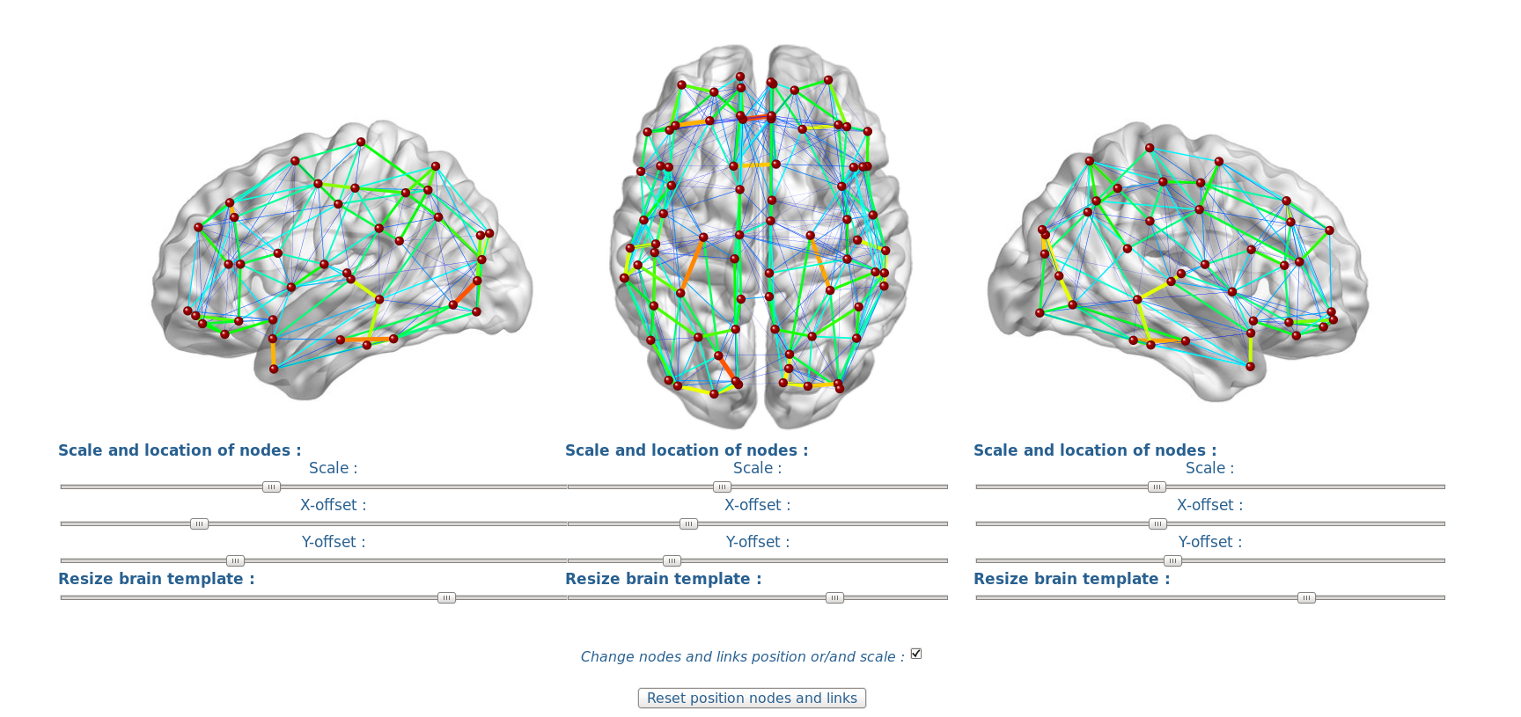
CIVILITY : cloud based Interactive Visualization of Tractography Brain Connectome
Appendices
X
2. Visualization of the brain connectome
Here you can visualize the connectivity on brains templates.
If your mouse is over the node, a tooltip indicates the seed name
The links are printed according to the threshold values specified.
You can re-scale and translate nodes and links
You can also re-size brains template
Y

Slide 21

CIVILITY : cloud based Interactive Visualization of Tractography Brain Connectome
Acknowledgment :
This work is part of the National Alliance for Medical Image Computing (NAMIC), funded by the National Institutes of Health through the NIH Roadmap for Medical Research, Grants U01 MH070890 – U54 HD079124 - R01 MH091351.
UNC : Danaele Puechmaille, Juan Carlos Prieto, Martin Styner
DP : danaele@email.unc.edu, JCP : jprieto@med.unc.edu, MS : styner@cs.unc.edu

